Slide 1
Introduction to Shell Scripting
Shell Script ,Unix Environment , Variables, Control flow, Functions

Slide 2
Course Contents
What is Shell ?
Introduction to Shell Script
Shell Offerings
Invoking Shell Script
Unix Profile files
Variables Type in Shell
Shell Prompt – PS1 and PS2
Positional Parameters
Aliases and Command History
Escaping and Quotation in Shell Scripts
Control flow in shell scripts
Operators in Shell Script
Functions in Shell Script
File status Operators in Shell Script
Team TEX

Slide 3
Pre-requistes
Basics understanding of Unix OS
Unix Process system
Basic Unix commands Knowledge

Slide 4
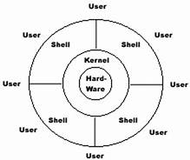
What is Shell ?
Shell is basically an application which sits between user and the kernel. Shell is a command line interpreter. A shell allows user to create new programs , call other shell scripts and run them in an interpretive mode after it is given executable permission. A shell is also a process(program in execution).
Unix Shell Interface

Slide 5
Introduction to Shell Script
A shell script contains sequence of operations ,which are usually combination of unix commands, group under single window. It is possible for shell script to invoke other shell script. The shell script contains sequence of commands which needs to be executed.
Full Shell Interpretive Cycle :: Following activities are usually performed by shell in a full cycle :
The prompt is issued by shell and waits for the user to enter command.
After a command has been entered, the shell scans the command line for metacharcters(*, >) and expand them to create a simplified command line expression( example replacing * with all filenames in current directory when used with ls *).
It then passes the command line to the kernel for execution.
The shell waits for the command to complete its execution.
After command execution is complete, the prompt re-appears and the shell again returns to its waiting role to start the new cycle.

Slide 6
Introduction to Shell Script
A shell script consists of a sequence of built-in and non-built-in commands which are generally separated by ; or new line.
Comments in the shell script start with # symbol. They are basically used for :
To identify who wrote the code and for what purpose.
Make code easy to read.
Version control tracking.
We can know the execution status of shell script with $? Command.
0 – success
except 0 - failure.
Drawbacks of Shell Script :
Shell Programs usually run slower than complied programs(like c),because the shell must interpret each unix command,inside the executable script file before it is executed.

Slide 7
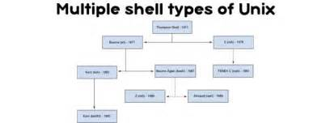
Shell Offerings
Unix systems offers a variety of shells. The major family of supported shells are :
sh - Bourne shell
bash - Bourne again shell
ksh - korn shell
csh - c shell
zsh - Z shell
Of, all the shells mentioned above, bourne shell(sh) is the primary and most commonly used. Usually all unix system have it by default. This shell generally doesn’t have the advanced interactive features which are supported by other shells. The shell scripts written within bourne shell are usually portable.. At the top of shell script, the path of shell is mentioned , starting with #.
For ex: for bourne shell we use: #!/bin/sh, for ksh we use #!/bin/ksh

Slide 8
Invoking Shell Script
It is mandatory to give the executable permission to the shell script before execution as below :
chmod +x abc.sh
A shell script can be invoked by number of ways :
sh filename.sh [arg-list]
./abc.sh [arg-list]
Thought it is not necessary but it is advisable to give the same extension to
the script file , as the interpreter name which is used to run it.
Example :
!/usr/bin/sh should have .sh extension.

Slide 9
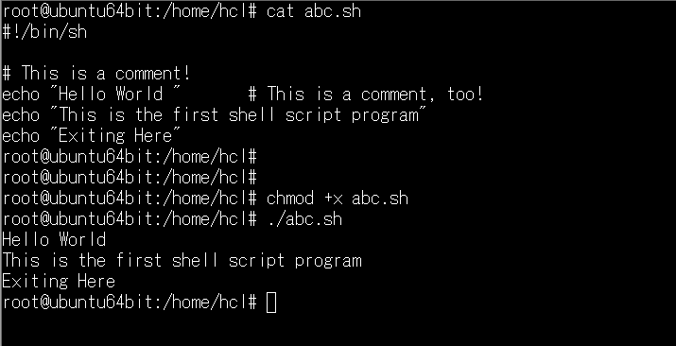
Invoking Shell Script - Example
Simple Shell Script Example

Slide 10
Unix Profile files
.bash_profile - This file is executed only once at startup. It is used when a specific user wants to have the personalized settings and want to override default settings.
.profile - is executed when .bash_profile is not present. Settings in this file override the default settings in /etc/profile. This is usually located in /etc directory. It stores the common environment variable for all users. This is used as the login script
.bash_login - This is used when both of the above two are not present.
.bashrc - This file is executed for non login shells. There is no rc file in bourne but bash and korn use it. It is defined by environment variable (BASH_ENV in bash and ENV in korn). The rc file will be executed after the profile.

Slide 11
Variables Type in Shell
Following variables are defined in shell :
Local variables - The scope of the local variables is only within the function they are defined.
beta()
{
local NUM=11
echo $NUMloc
}
Shell variables - are those which retain there value in the current shell session i.e from the time when the user login to the shell until the point user exits.
NUMBER=11 - sets value of shell variable
echo $NUMBER, ${NUMBER},$[NUMBER] - used to display the value of shell variable.
set - display all the shell variables, including environment variables.
unset NUMBER - to unset the value of variable

Slide 12
Variables Type in Shell
Environment variables.-- these are those variables which are visible in users total environment including sub-shells, all processes created by parent shell etc.
env - command is used to display on the environment variables.
export - is used to set or update the environment variables.
Environment variables do not propagate to the parent shell which creates the sub-shell.
A list of common Environment variable is shown below.
Variable | Description
PS1 | Your default (first) shell prompt(Primary Prompt)
USER | Current logged in user's name.
PATH | Colon separated list of directories to search for binaries.
DISPLAY | Network name of the X11 display to connect to, if available.
HISTFILESIZE | The maximum number of lines contained in the history file(used with history command)
HOSTNAME | The system's host name
LD_LIBRARY_PATH | It is a colon-separated set of directories where libraries should be searched for

Slide 13
Shell Prompt – PS1 and PS2
PS1- is the default prompt provided to user immediately after login. In this prompt user can interact with shell and provide shell commands. Default interaction prompt for root is #.
PS2 - is the secondary prompt or continuation prompt. Default value of PS2 is ">".
We can customize the value of PS1 /PS2 prompts according to your needs.
PS1='[$PWD]'
[/home/hcl]
PS1="\h \u \w"
\h- hostname of computer
\u- username
\w -Full path of current directory.

Slide 14
Positional Parameters
The parameters which are passed to the script from the command line. Following are some of the most commonly used positional parameters.
Symbol | Meaning
$# | Total number of arguments
$0 | Name of the script file
$1,$2,$3 | First, Second,Third argument specifically.
$* | Retuns a single string comprising of all positional parameters*”$1 $2 ..$n”
$@ | Returns a sequence os string of positional parameters(“$1”,”$2”,…”$n”)

Slide 15
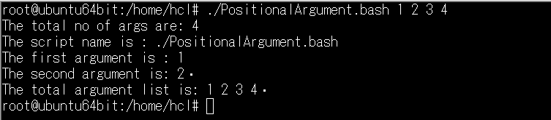
Positional Parameters - Example
cat PositionalArgument.bash
#!/usr/bin/bash
echo "The total no of args are: $#"
echo "The script name is : $0"
echo "The first argument is : $1"
echo "The second argument is: $2“
echo "The total argument list is: $*“

Slide 16
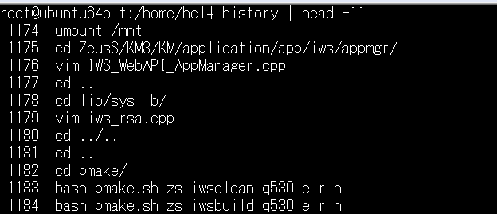
Aliases and Command History
Alias - allows user to assign shorthand names to frequently used commands .Alias is created with the help of alias keyword.
alias list='ls -lrt'
list
alias rim="rm *"
rim
History - Bash and korn shell provides a feature called history which treats the previous command as event and associates the event number with it. Using this number we can re-execute these commands.
history will display a list of previously executed commands

Slide 17
Escaping and Quotation in Shell Scripts
Below are some of the examples highlighting the use of “’’, ``(quotes) in shell scripts.
echo "I am a student of Unix Shell Scripting"
echo 'I am a student of Unix Shell Scripting'
echo -n "Hello Shell!" #hides new line
echo "$HOME“ #To print environment variables.
echo '$HOME’ #displays only HOME , no expansion of variables.
echo $HOME
echo "Displaying the \$HOME directory" -#no expansion used here as \ is used.
echo "Expansion using embedded `$PATH`“ – #use of `` for shell commands in script.

Slide 18
Control flow in Shell Scripts
The basic logical structures needed for program development are :
Sequential logic - To execute the commands in order which they appear.
Decision logic -To execute the commands only if the condition is true.
Looping logic - To repeat a series of command for a given number of times.
Case logic - It can be used as an alternative to multiple if/else/elif block.
A shell script can be made flexible by including a series of flexible statements which include :
if/else/elif
break/continue/switch
while/foreach/until

Slide 19
Control flow in shell scripts – Decision statements
The logical flow in the shell script is provided by if/else/elif statements.
if (expr) then list-of-commands
fi
or
if(expr)
then
list-of-commands
elif(expr)
then
list-of-commands
else
list-of-commands
fi

Slide 20
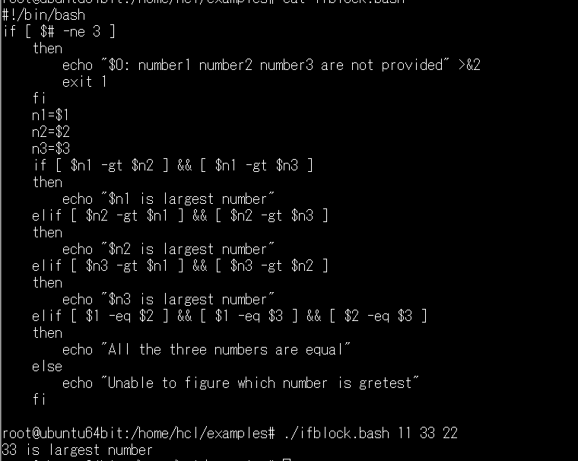
Control flow in shell scripts – Decision statements(Example)
Simple program to show usage of If/else block:

Slide 21
Control flow in shell scripts – Switch Block
Switch - A switch block can be used as an alternative to multiple if/else block .
It allows you to perform one of many actions depending upon the value of variable.
Below is the syntax of switch block in Shell Script.
case pattern in
pattern1)
Statement(s) to be executed if pattern1 matches
;;
pattern2)
Statement(s) to be executed if pattern2 matches
;;
pattern3)
Statement(s) to be executed if pattern3 matches
;;
*)
Default condition to be executed
;;
esac

Slide 22
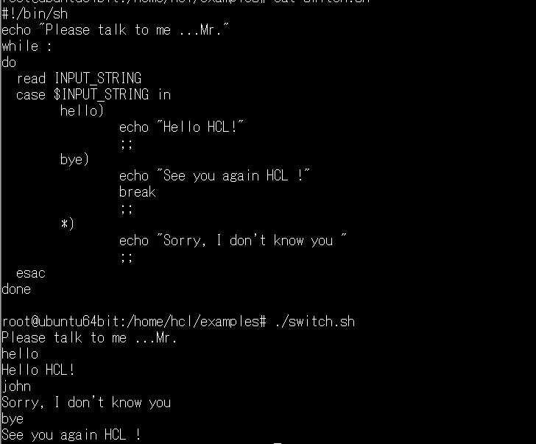
Control flow in shell scripts – Switch Block(Example)
Simple program to show usage of If/else block:

Slide 23
Control flow in Shell Scripts – Looping
A loop is a programming mechanism which is used when we want to repeat a task. A loop allows a set of instructions to be executed repeatedly. Loops are broadly classified into following categories :
For loop - for loops iterate through a set of values until the list is exhausted.
While loop - The while command executes a series of command until the condition is true.
Until loop - It is opposite to that of while loop. The loop is executed as long as the condition is false.

Slide 24
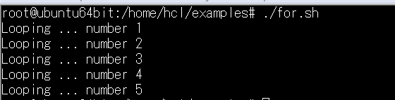
Control flow in shell scripts – Looping(Examples)
Syntax :
for (iterate a list)
do
Statement(s) to be executed until condition is true
done
Example :
#!/bin/sh
for i in 1 2 3 4 5
do
echo "Looping ... number $i"
done

Slide 25
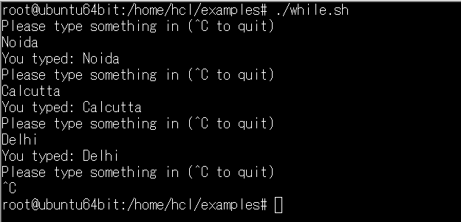
Control flow in shell scripts – Looping(Examples)
Syntax :
while(expr)
command-list
end
Example :
#!/bin/sh
while :
do
echo "Please type something in (^C to quit)"
read INPUT_STRING
echo "You typed: $INPUT_STRING"
done

Slide 26
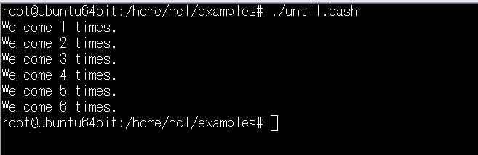
Control flow in shell scripts – Looping(Examples)
Syntax :
until [ condition ]
do
command1 command2 ... .... commandN
done
Example :
#!/bin/bash
i=1
until [ $i -gt 6 ]
do
echo "Welcome $i times."
i=$(( i+1 ))
done

Slide 27
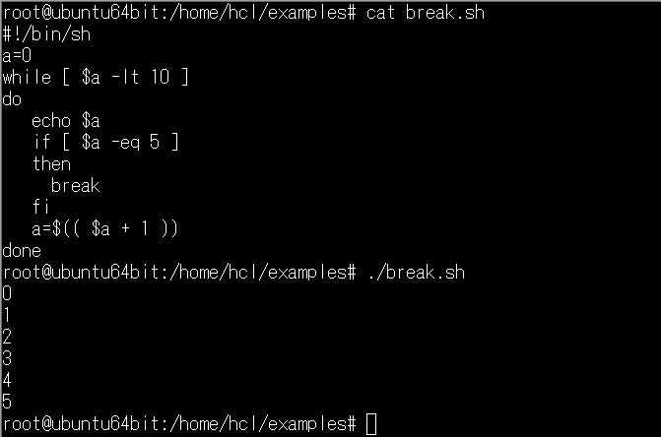
Control flow in shell scripts – Looping(Examples)
break and continue are built-in shell functions and they are used to escape from or advance within a while, for, foreach or until loop .
Syntax :
break [n]
continue [n]
n -The number of nested loops to break . The default number is 1.
Example :

Slide 28
Operators in Shell Script
Below are some of the commonly used operators in Shell Scripting :
Operators | Symbol
= | Assignment Operator
, -, *, /,**,%,+=,*=,%= | Arithmetic Operator
<<,<<=,>>,>>=,&&,&=,|,|=,~,!,^,^= | Bitwise Operator
&&,|| | Logical Operator
, | Comma Operator

Slide 29
Operators in Shell Script - Examples
Operator | Description | Example | Evaluates To
+ | Addition | echo $(( 20 + 5 )) | 25
- | Subtraction | echo $(( 20 - 5 )) | 15
/ | Division | echo $(( 20 / 5 )) | 4
* | Multiplication | echo $(( 20 * 5 )) | 100
% | Modulus | echo $(( 20 % 3 )) | 2
++ | post-increment (add variable value by 1) | x=5 echo $(( x++ )) echo $(( x++ )) | 5 6
-- | post-decrement (subtract variable value by 1) | x=5 echo $(( x-- )) | 4
** | Exponentiation | x=2 y=3 echo $(( x ** y )) | 8

Slide 30
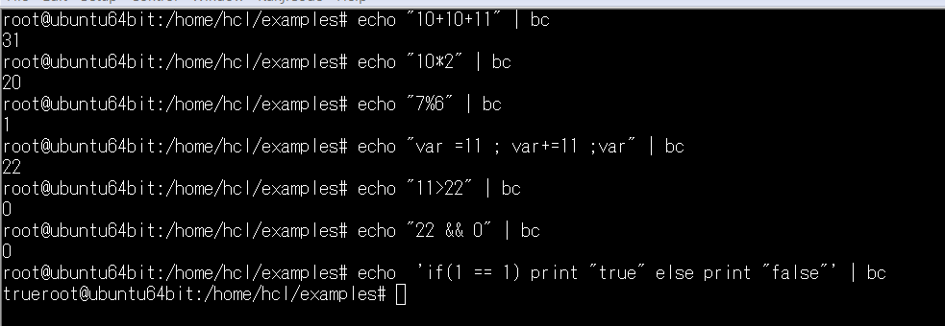
Arithmetic Operations –Usage of bc Command
bc(bench calculator) - command is used as an alternative to expr command for performing Arithmetic Operations. bc can also be used in shell script for evaluating Arithmetic Operations. It can perform following operations:
Arithmetic operators
Increment and decrements
Assignment
Comparison
Logical or Boolean operators

Slide 31
Functions in Shell Script
Function is a way of grouping together commands, so that they can be executed later via single reference to there name.
To avoid large and complicated scripts use functions.
You can divide large scripts into a small chunks/entities called functions. This will save us from excess of coding and typing errors.
Functions makes shell script modular and easy to use and perform a specific task.
In other high level programming languages function is also known as procedure, method, subroutine, or routine.
Syntax:
function_name(){
//set of commands
}

Slide 32
Invoking functions in Shell Script
Simple hello function example:
hello()
{
echo 'Hello world!' ;
}
Function with Arguments :
hello() {
echo "Hello and Welcome to $1, Our country has diversified culture" ;
}
Calling Function
hello India
Hello and Welcome to India, Our country has diversified culture

Slide 33
Displaying function names
To display the defined function name, user needs to use declare command.
declare –f
declare -f hello
declare -f parse_args()
Output
hello()
{
echo 'Hello world!' ;
}
unset -f functionName - To Remove function name.

Slide 34
File Status Operators in Shell Script
Testing File Permissions is one of the essential part of Shell Programming. Following are the major File test operators :
Operator | Meaning
-nt | FILE1 is newer (modification date) than FILE2
-ot | FILE1 is older than FILE2
-b | FILE exists and is block special
-c | FILE exists and is character special
-d | FILE exists and is a directory
-e | FILE exists
-f | FILE exists and is a regular file
-r | FILE exists and read permission is granted
-w | FILE exists and write permission is granted

Slide 35
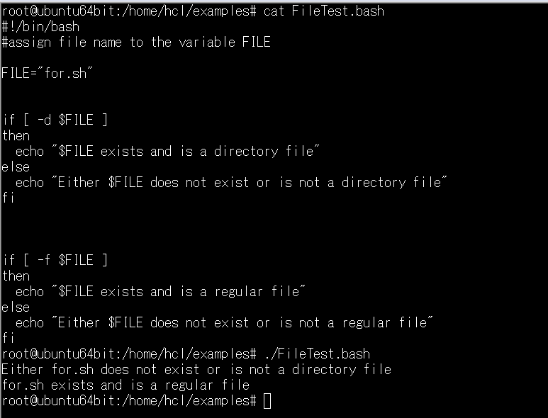
File Status Operators in Shell Script - Examples
Below example highlights the file test operator usage :

Slide 36
Thankyou

